Slide 1

online Event MANAGEMENT SYSTEM

Slide 2

TEAM MEMBERS
A. Koushik
G. Prathyusha
N. Nikhitha
M. Hasvika
Ch. Raghavender

Slide 3
PROJECT INTRODUCTION
“Online Event management system” is the application of event management to book venues for events and parties.
The project provides most of the basic functionality required for an event.
This project helps to manage different events for different occasions.
This system helps the firm to receive the orders from different clients irrespective of their location.
.

Slide 4
OBJECTIVES OF project
Our aim is to make a user friendly application that can let a user to plan an event.
The project will help clients to book an event and the cost required for particular booking. No need to visit managers.
User can select the event and according to the event, the appropriate booking can be made.
Client will also find out the cost for particular event and virtual representation of that particular event.

Slide 5

Requirements
Software Requirements
Windows version 7+.
Front-end software: Angular, HTML & CSS.
Back-end software: MySQL Database and also Spring Boot.
A browser which supports HTML & JavaScript.

Slide 6


USED TOOLs
Frontend- Visual studio code.
Backend- Spring tool suite
MySQL Database.
Online Tools
Word
PowerPoint .

Slide 7
EXISTING SYSTEM
Time consuming process.
Registrations are made by man to man.
Complicated to visit and select event venues.
Required more man power.

Slide 8
PROPOSED SYSTEM
Organizer: In this new proposed system we will provide an organizer to manage events.
Registration: Participants can register online for an event.
Speed: The new proposed system is very fast with 100% accuracy and saves time.
Manpower: The new proposed system needs less manpower.

Slide 9
Advantages
Less man power consumption.
Easy future reference.
Option to save the details in database.
It costs less amount.
Collect payments through a safe & secure service.
You can book events 24x7.
You can stay in touch more easily.

Slide 10
ADMIN CASE DIAGRAM
ADMI
N
Database Queries
Login
View booking
Log out
Stop
View venues
View organizers
View users

Slide 11
ER DIAGRAM
Login
Login
View booking
Register
View venues
Manage venues
Admin
Organizer
View organizers
View bookings
View users
Booking history

Slide 12
ER DIAGRAM OF USER
Register
Booking history
Login
Payment
User
View venues
Book event

Slide 13
ACTIVITY DIAGRAM
ORGANIZER
Login
Register
Manage venues
View bookings
Booking history
ADMIN
Login
View booking
View venues
View organizers
View users
USER
Login
Register
View venues
Book event
Booking history
Payment

Slide 14
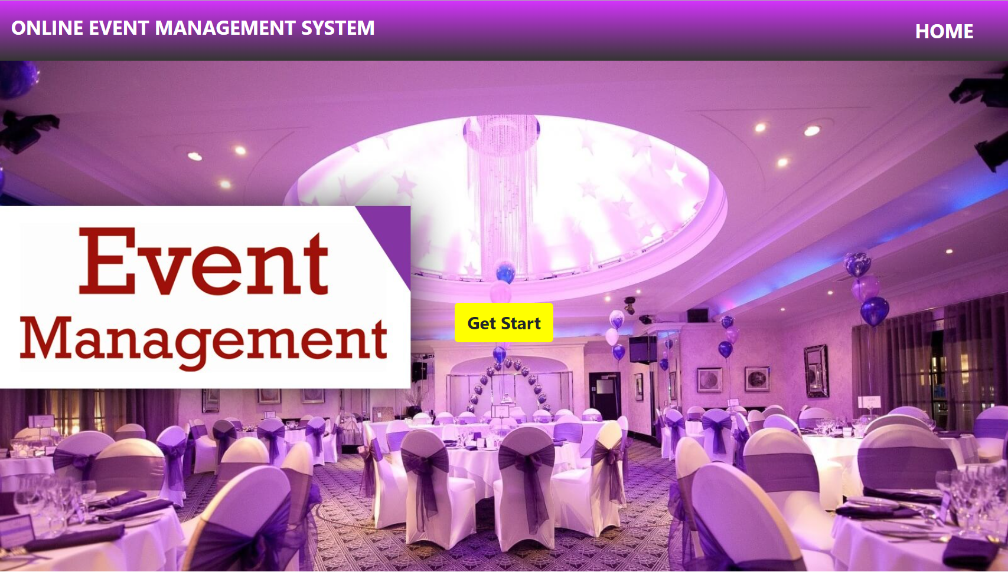
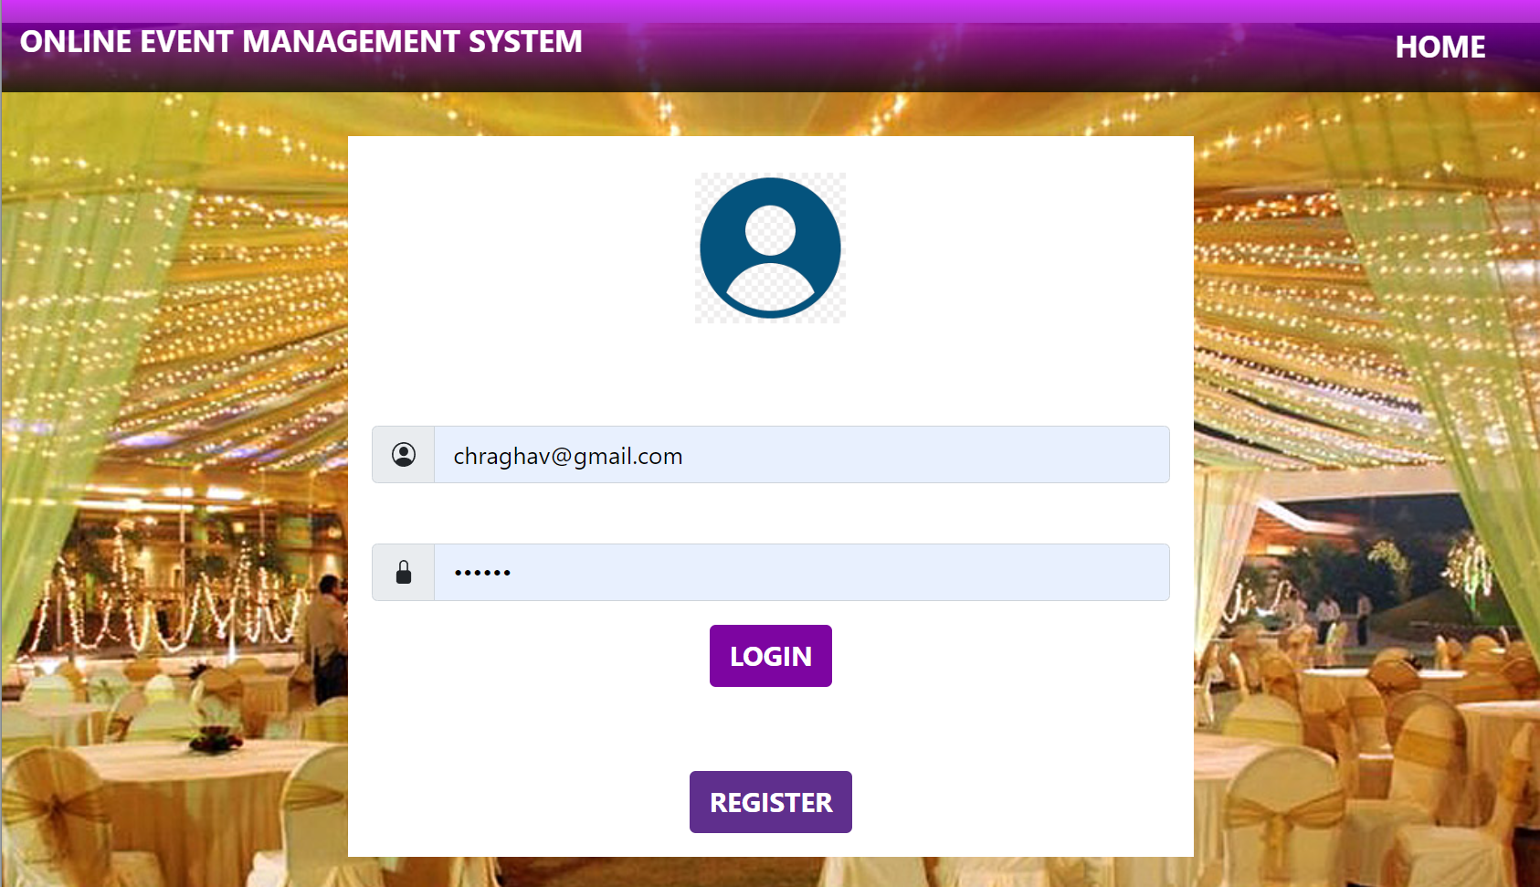
HOME PAGE
logIN PAGE

Slide 15
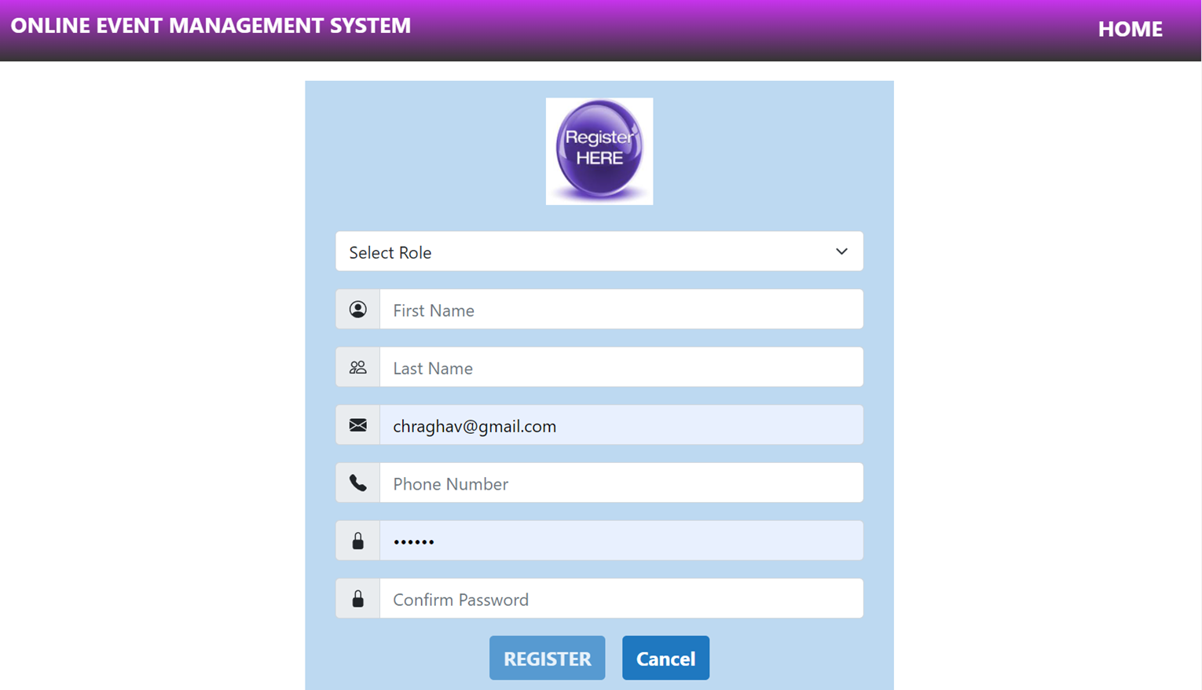
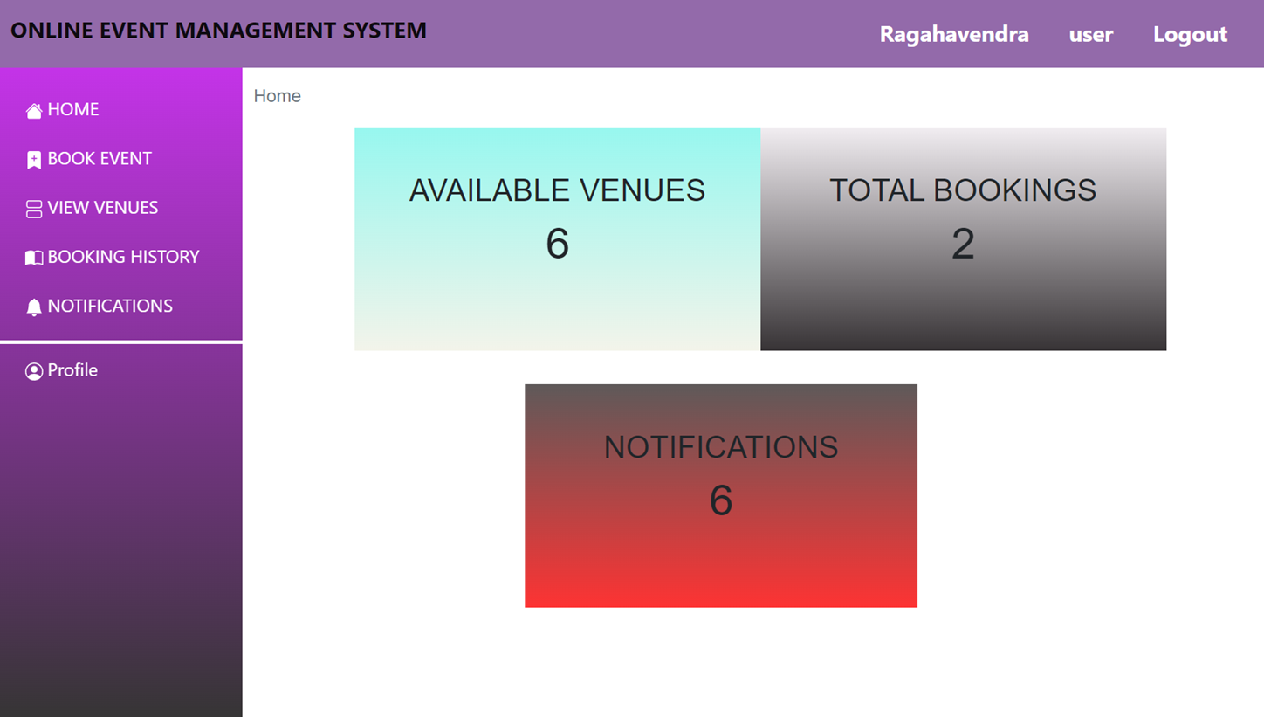
REGISTRATION PAGE
user home PAGE

Slide 16
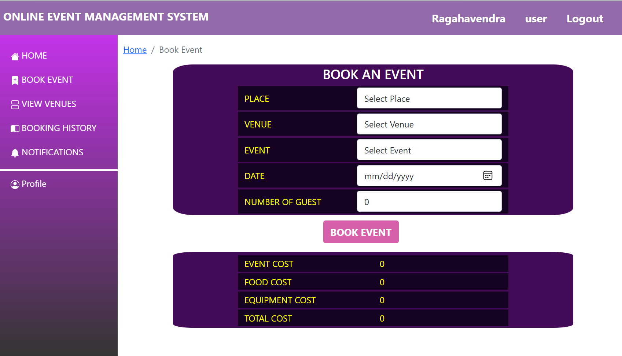
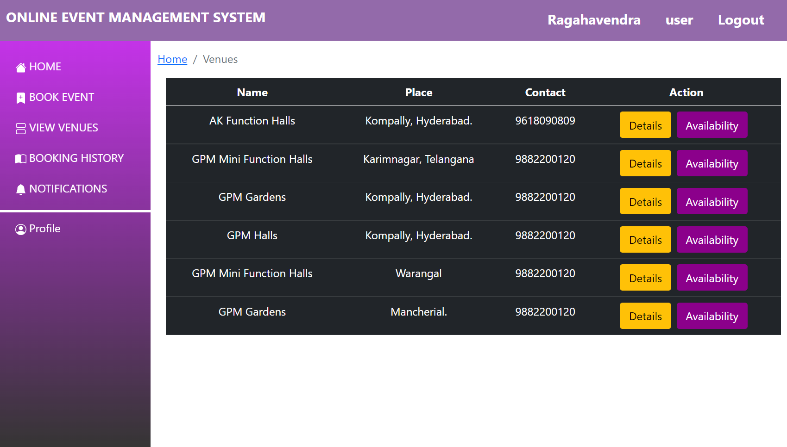
VIEW VENUES PAGE
Book event PAGE

Slide 17
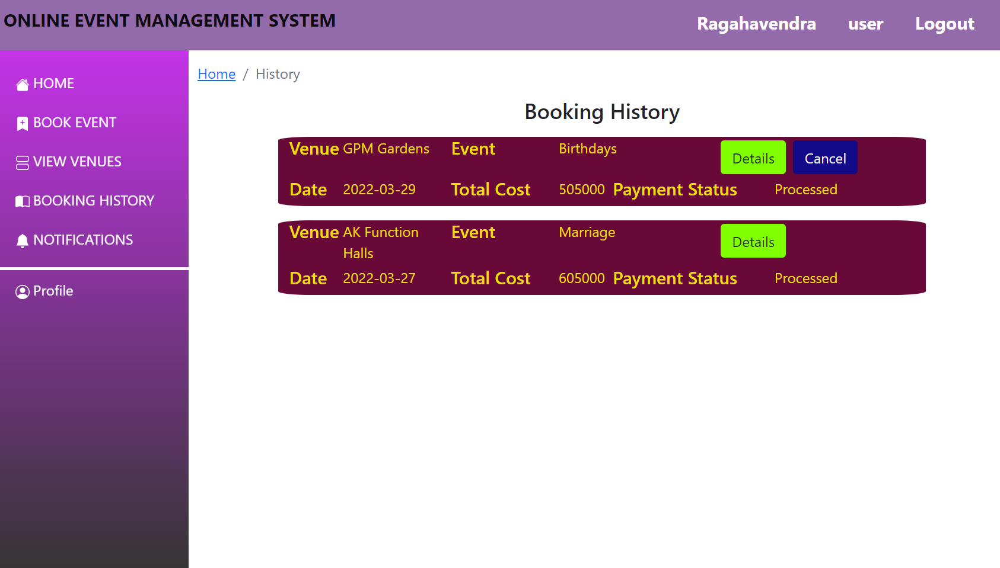
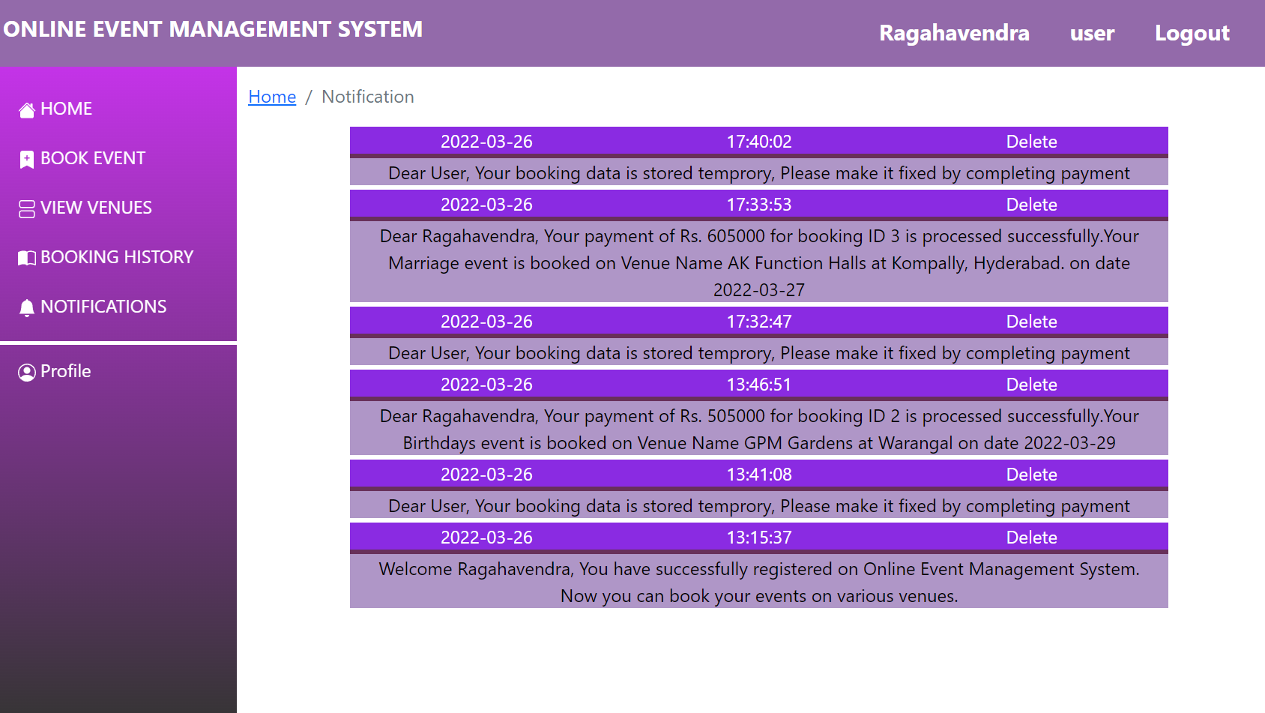
BOOKING HISTORY PAGE
NOTIFICATIONS PAGE

Slide 18
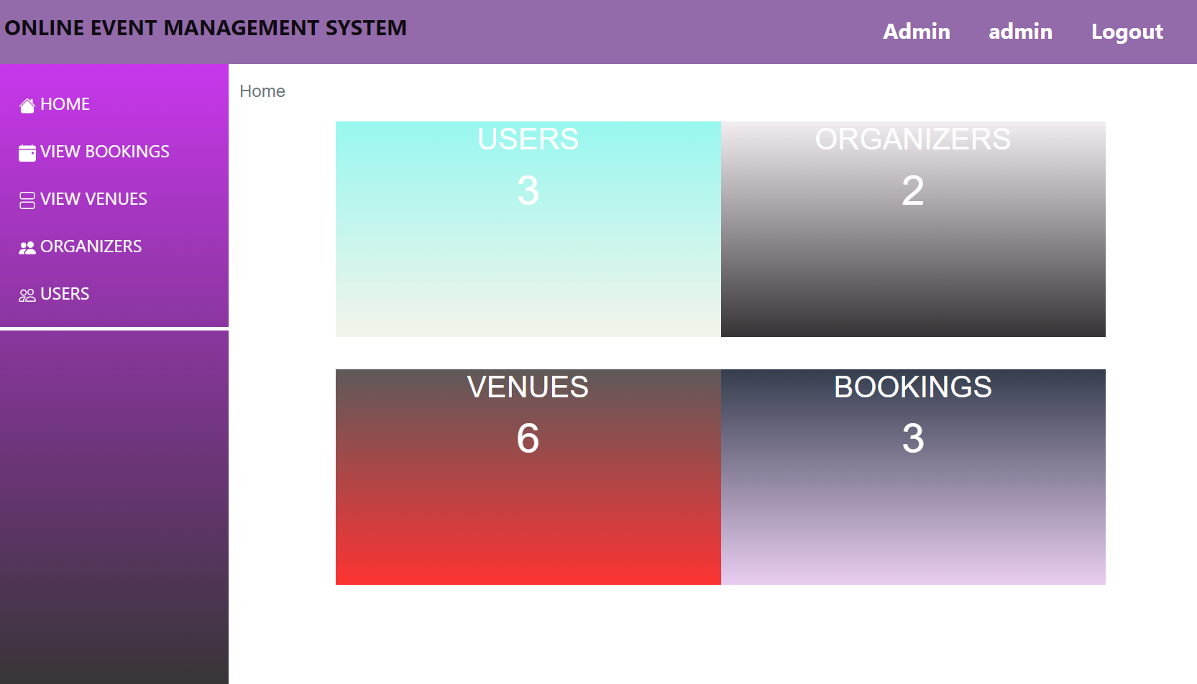
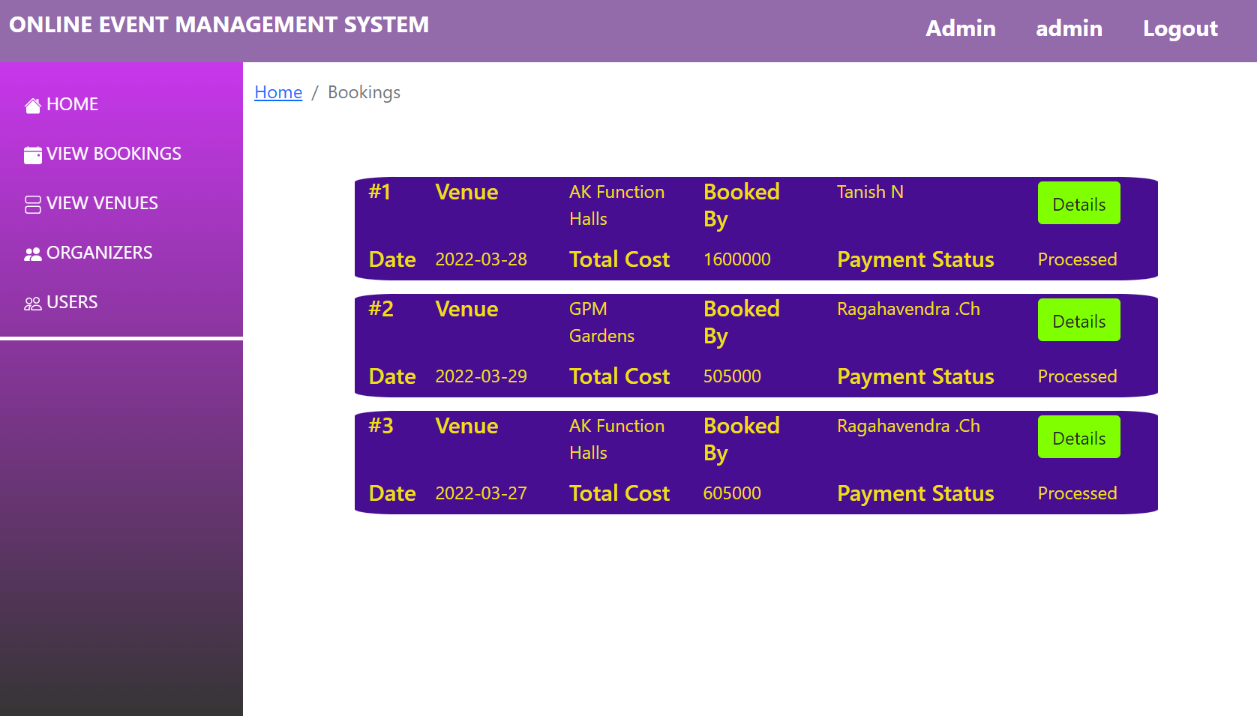
ADMIN HOME PAGE
VIEW BOOKINGS PAGE

Slide 19
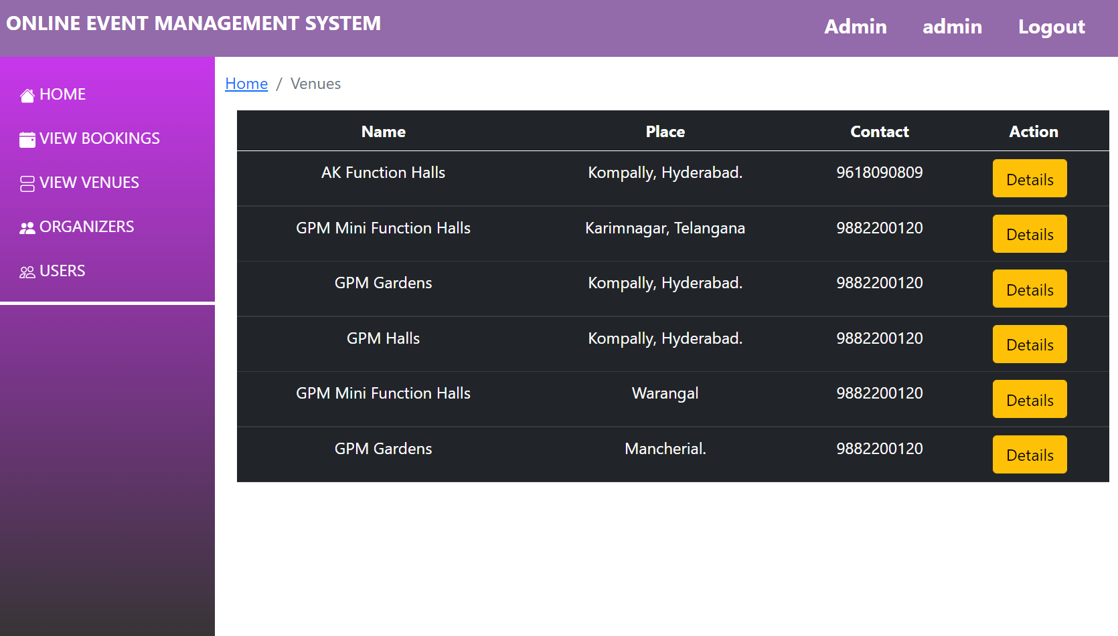
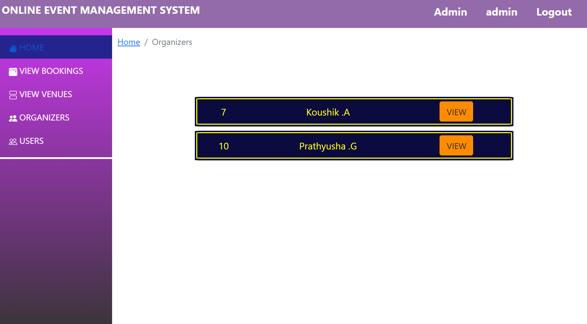
VIEW VENUES PAGE
ORGANIZERS PAGE

Slide 20
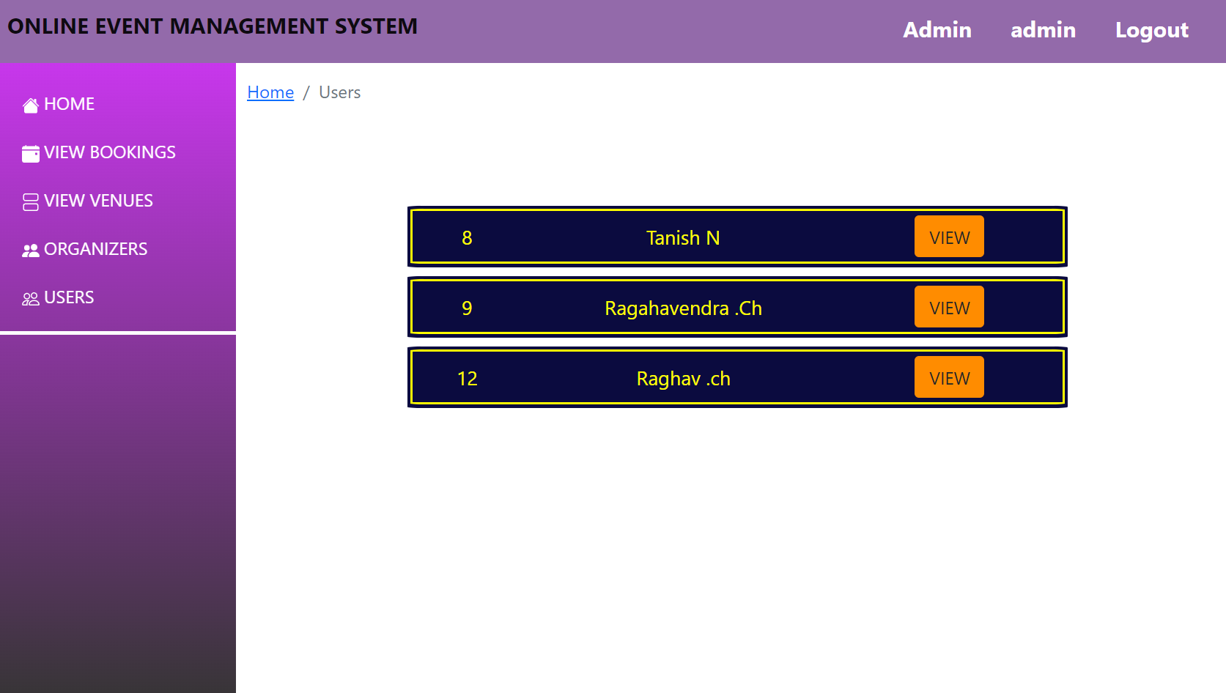
USERS PAGE

Slide 21
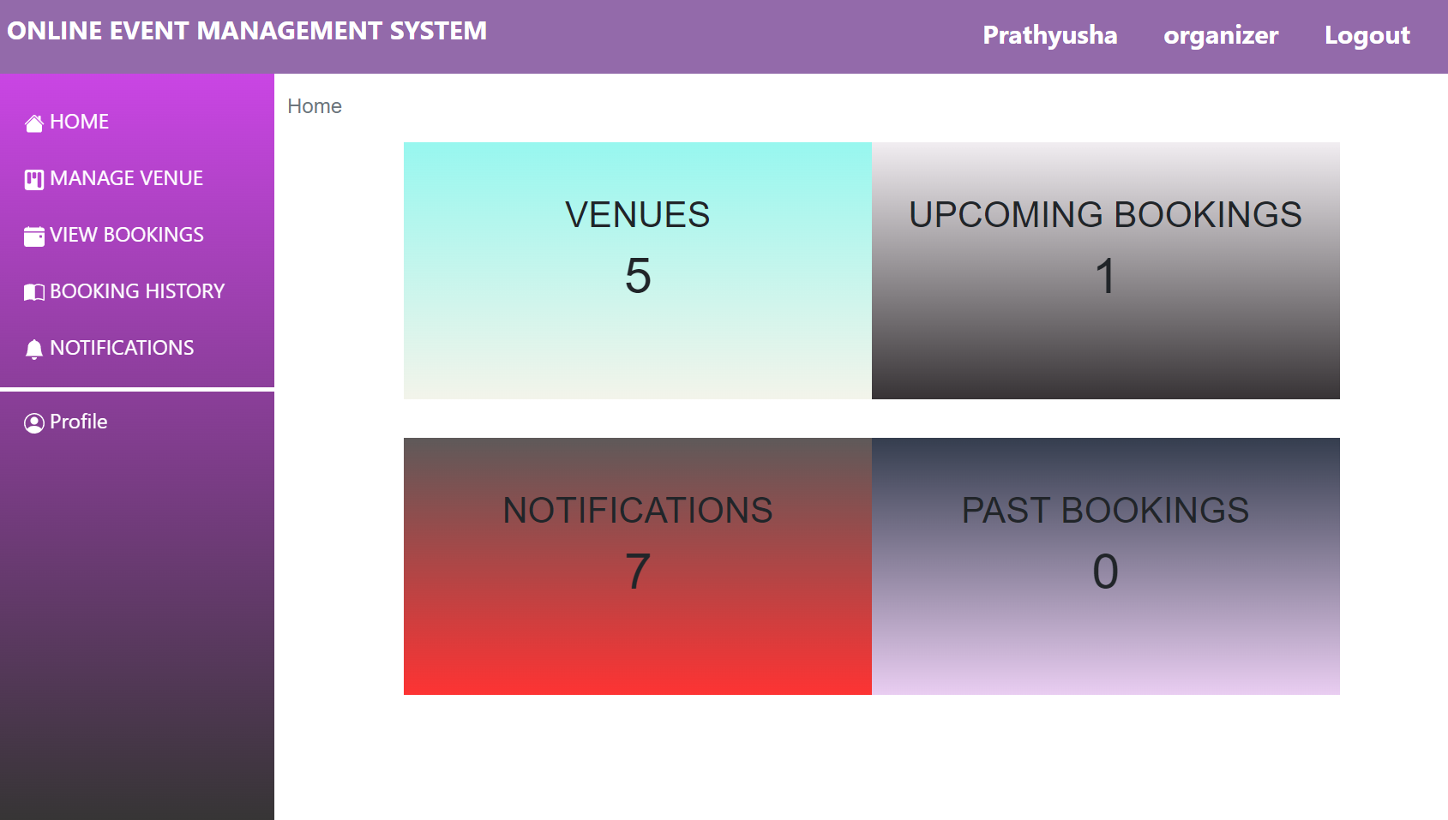
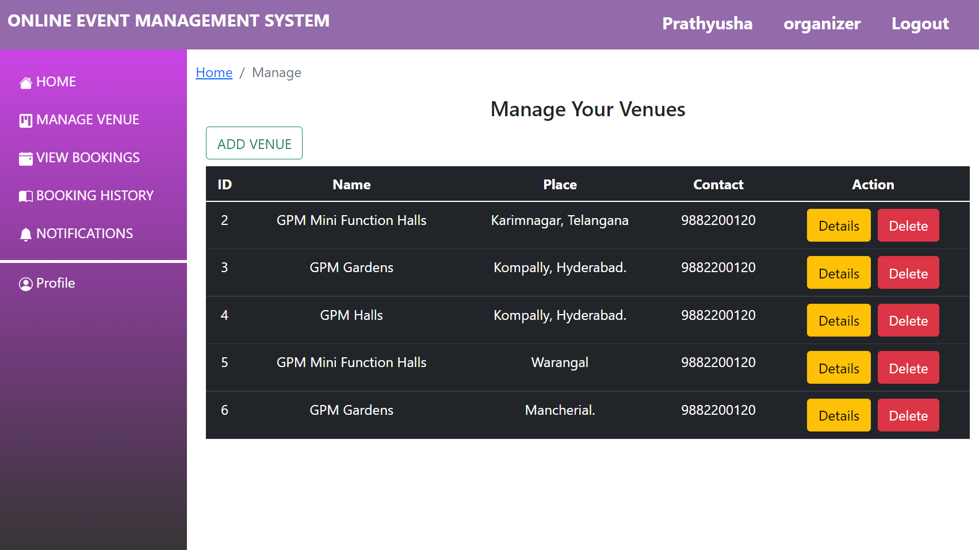
Organizer HOME page
MANAGE VENUE page

Slide 22
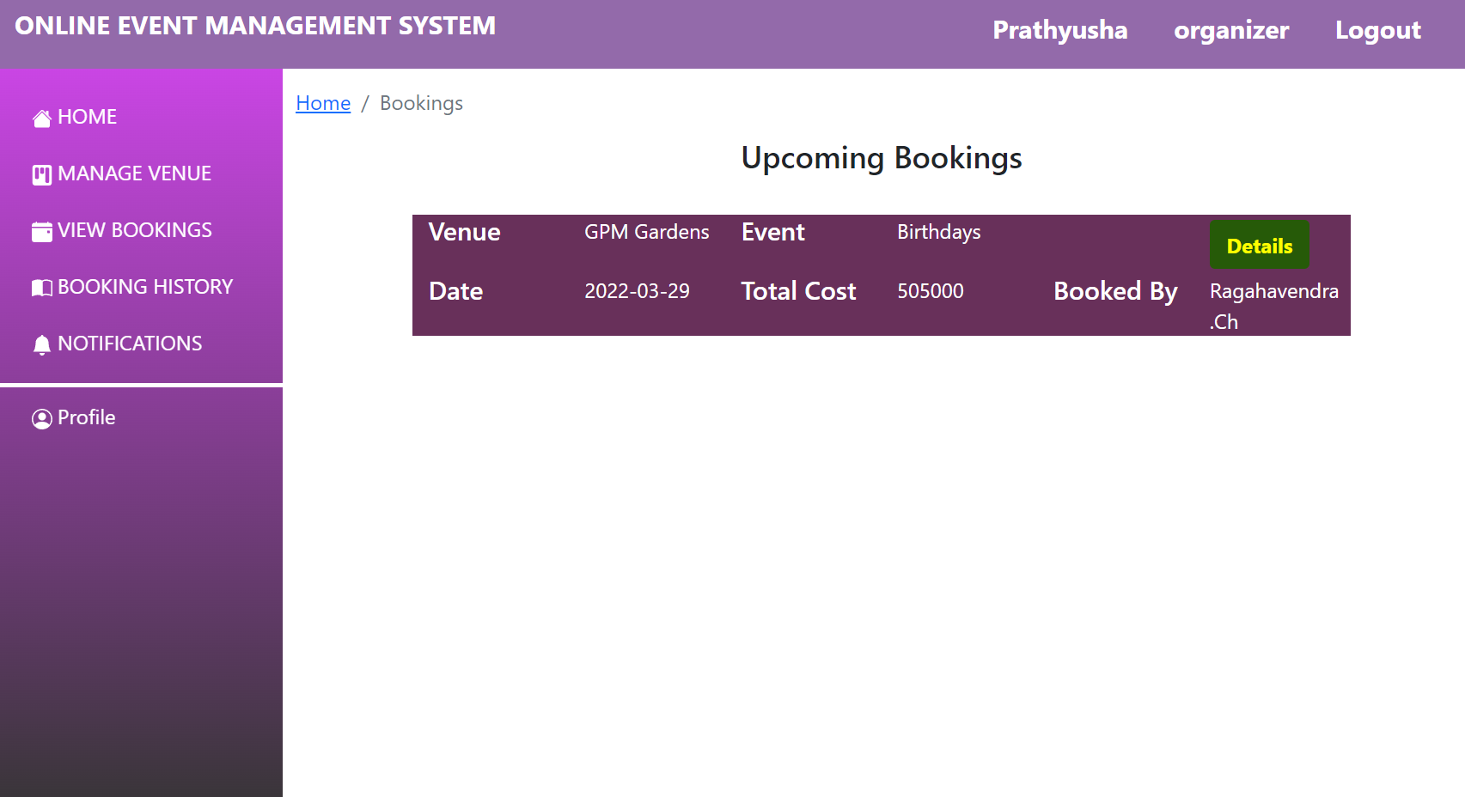
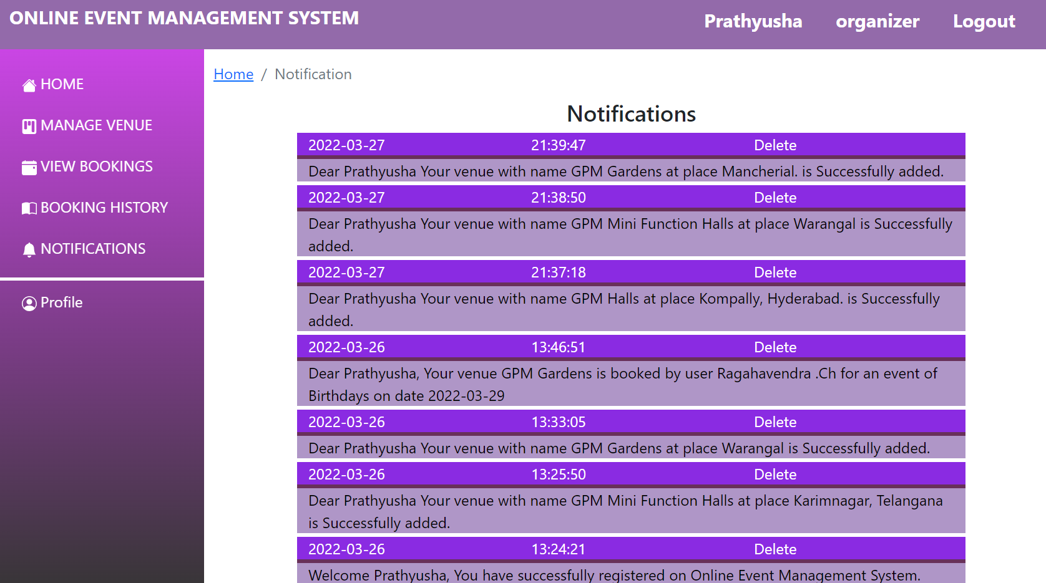
VIEW VOOKINGS PAGE
NOTIFICATIONS PAGE

Slide 23

FUTURE ENHANCEMENT
We will provide the security system and privacy more.
Forecasting is concerned with future events.
Create a comment box for your queries and reviews.
To bring all factors together to produce a workable event.

Slide 24


